Slide 1

IOT BASED BANK LOCKER SECURITY SYSTEM

Slide 2
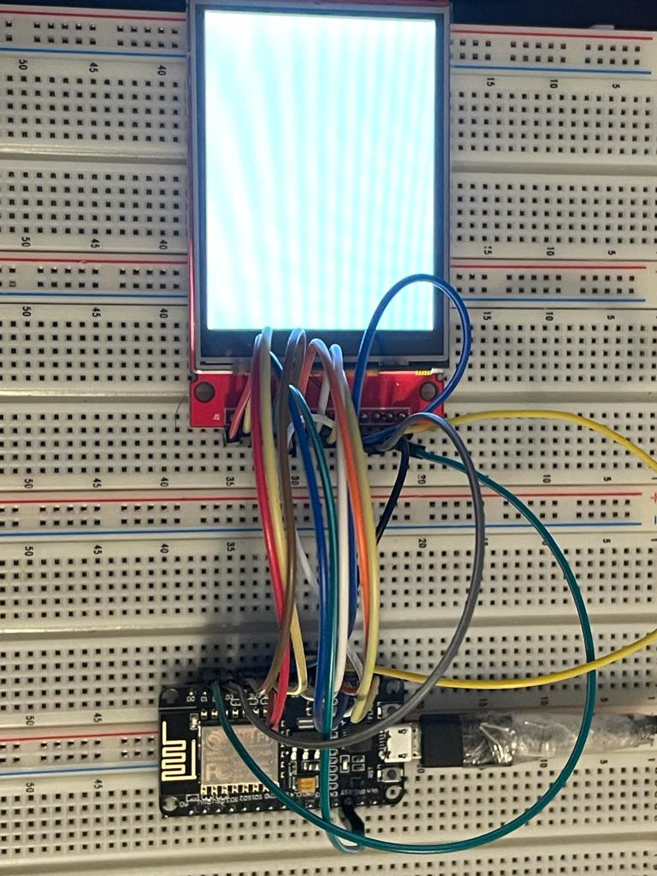
Interfacing 2.8” TFT Touch Screen with ESP8266
Submitted by: SIMRAN
C0765503

Slide 3
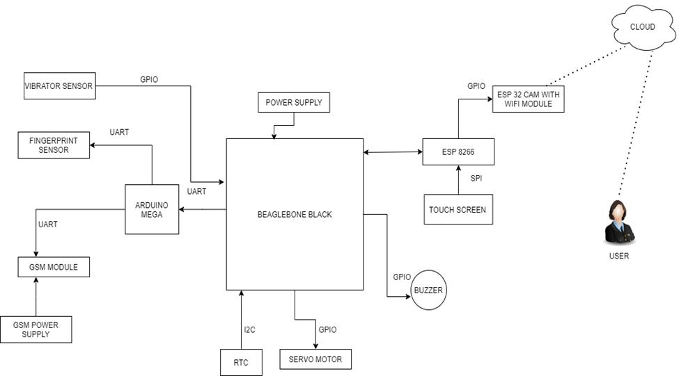
Block Diagram for project

Slide 4
What is SPI Communication?

Slide 5

It is a synchronous data bus
It uses separate line for clock and data, that keep both sides perfect.
In SPI, only one side generates the clock signal, usually named as CLK or SCK (Serial Clock). The side that generates the clock is called the controller
The other side is called the peripheral. There is always only one controller, but there can be multiple peripherals.

Slide 6
SPI Communication
SPI are in a master-slave relationship. The master is the controlling device usually a microcontroller, while the slave usually a sensor, display, or memory chip takes instruction from the master.
The simplest configuration of SPI is a single master, single slave system, but one master can control more than one slave
One unique benefit of SPI is the fact that data can be transferred without interruption, any number of bits can be sent or received in a continuous stream.
Generally, it is a four-wire communication.

Slide 7
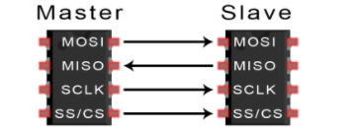
Important terms for SPI

Slide 8
Important Terms For SPI
MOSI (Master Output/Slave Input) – Line for the master to send data to the slave.
MISO (Master Input/Slave Output) – Line for the slave to send data to the master.
SCLK (Clock) – Line for the clock signal.
SS/CS (Slave Select/Chip Select) – Line for the master to select which slave to send data to.

Slide 9
Chip Select
This pin plays a very vital role in the SPI Communication, as its like a wake-up call for the peripheral devices.
Mainly, CS just awake the peripheral devices, with whom the main device can exchange data, like to send or receive data.
It is very useful when the master is connected to multiple slave devices, at that time the CS determines which slave device is needed by the master at that moment.

Slide 10
Requirements for Interfacing
Hardware Requirements
Software Requirements
2.8” TFT Touch screen
Breadboard
ESP8266
Jumper wires
USB Wire
Arduino IDE

Slide 11

TFT Touch screen
TFTs, also called TFT screens, are a type of active-matrix LCD display capable of displaying millions of high-contrast, clear and bright color pixels. TFTs are used in HDTV sets, computer monitors, laptop monitors, tablets, personal media players, smartphones and even feature phones.

Slide 12
Role of Touch screen in my project
We are using the touch screen as a first level security, for the Bank locker System.
So, the user need to enter the password before using the fingerprint sensor.
If the password, does not match then directly the buzzer will activate and the image will be taken by the camera, and send to the cloud.
If the password matches then, the fingerprint sensor is activating, and the fingerprints match, locker will open.

Slide 13
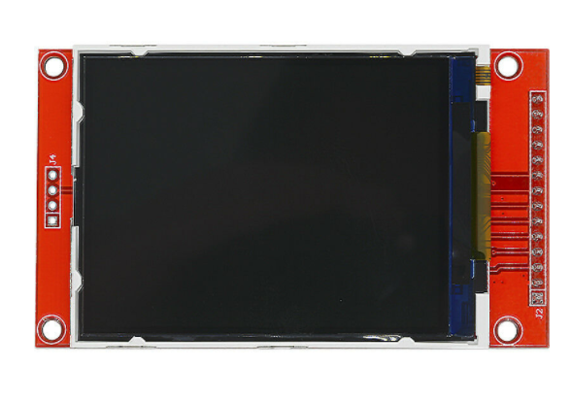
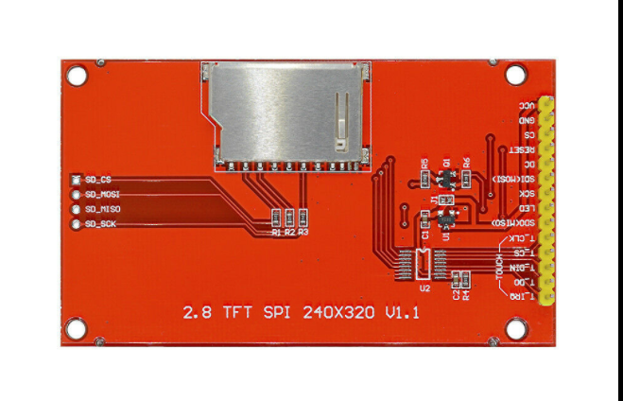
2.8” TFT Touch Screen

Slide 14
2.8” TFT Touch Screen
This is a 2.8-inch serial SPI color display module with touch function. It supports both analog SPI and hardware SPI. It is designed with PC plate including power supply IC and SD.
better performance in terms of adjusting the pixels within the display to get better quality.
2.8- inch TFT LCD shield touch screen with SD card socket, easy to use
Durable hard PCB ILI9341 board and metal, ideal for 5110 interface
Support Serial Mode and hardware SPI, so very convenient to use.
5V compatible, use with 3.3V or 5V logic

Slide 15
Features of Touch Screen
Resolution: 240x320
Driver IC: ILI9341
Input Voltage: 5V/3.3V
Color: 64k
Display Module: 1
Display area: 46(W) X 65(H)mm
Size: 86 x 50 mm

Slide 16
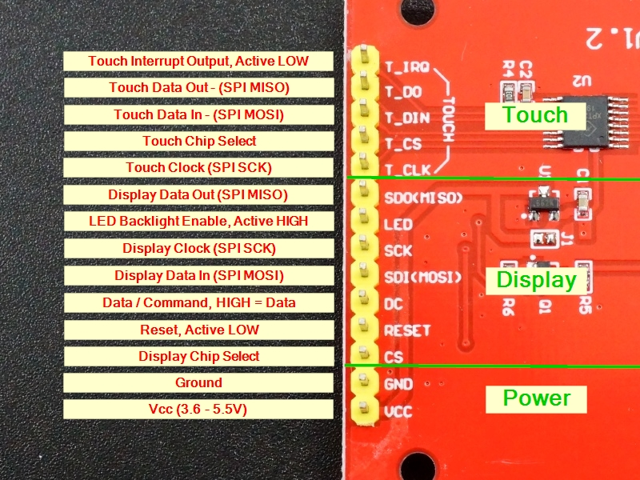
Pin description of Touch screen

Slide 17
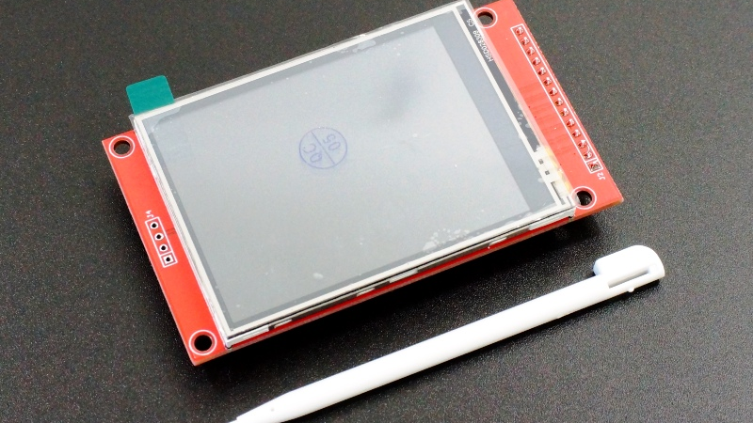
Touchscreen Resistive or Capacitive touch?

Slide 18
Resistive Touch
For this project, we are using 2.8” TFT Touch screen, this touch screen is resistive touch.
Resistive touch is better than capacitive as, it is cheaper in price.
It has better resistance with dust and water.
Can be use while wearing gloves.

Slide 19
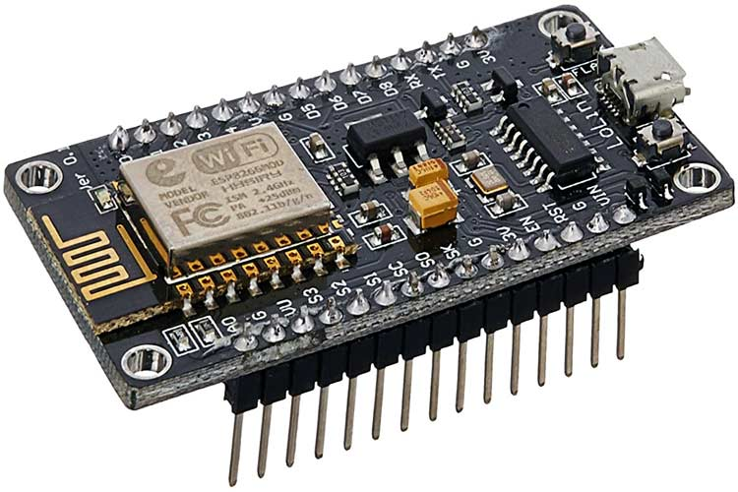
ESP8266
The NodeMCU (Node Microcontroller Unit) is an open-source software and hardware development environment built around an inexpensive System-on-a-Chip (SoC) called the ESP8266.
The ESP8266, designed and manufactured by Espressif Systems, contains the crucial elements of a computer: CPU, RAM, networking (Wi-Fi), and even a modern operating system and SDK.

Slide 20
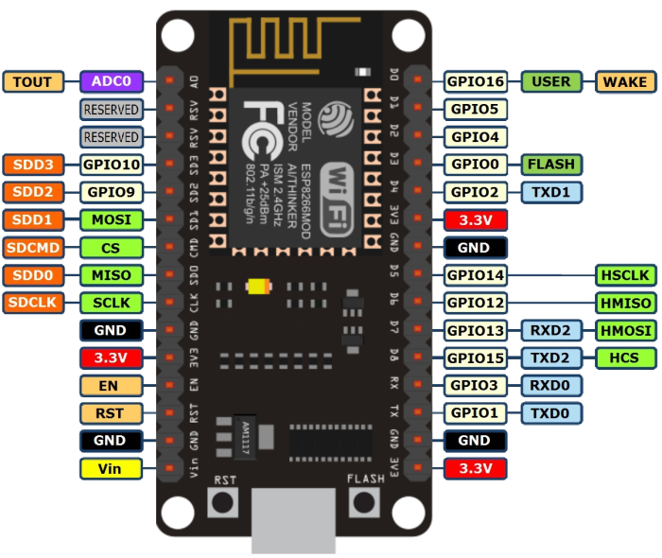
PIN DISCRIPTION

Slide 21
Features of ESP8266
This microprocessor supports RTOS and operates at 80MHz to 160 MHz adjustable clock frequency.
NodeMCU has 128 KB RAM and 4MB of Flash memory to store data and programs.
High processing power with in-built Wi-Fi / Bluetooth and Deep Sleep Operating features make it ideal for IoT projects.
NodeMCU can be powered using Micro USB jack and VIN pin (External Supply Pin).
It supports UART, SPI, and I2C interface.

Slide 22
Role of ESP8266 in my project
ESP8266, is used in this project only as a bridge between the touchscreen and Beagle bone black.
ESP8266 is being interfaced with the 2.8” TFT touch screen using the SPI communication protocol.

Slide 23
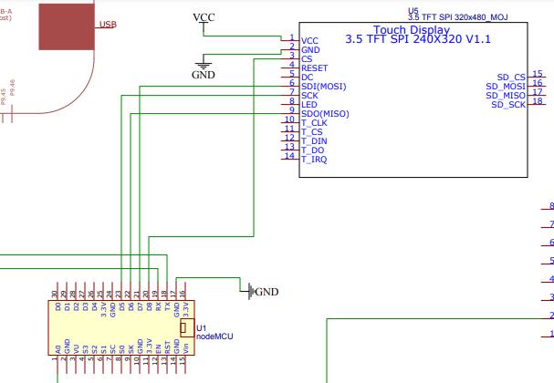
Schematic design

Slide 24
Hardware Connections
ESP8266 | TOUCH SCREEN
3.3V | VCC
GND | GND
D8 | CS
RST | RESET
D4 | DC
D7 | SDI
D5 | SCK
3.3V | LED
D6 | SDD

Slide 25
Hardware Connections
ESP8266 | TOUCH SCREEN
D5 | T_CLK
D2 | T_CS
D7 | T_DIN
D6 | T_DO
D1 | T_IRQ

Slide 26
Connecting ESP8266 With Touch screen

Slide 27

Arduino IDE
For this interfacing of TFT Touch Screen and ESP8266, we are using Arduino IDE as a software part.
Also, we need to download esp8266 board in the Arduino IDE.
The required libraries for the interfacing need to be downloaded before loading the code.
Code is written in the window, and after complaining, flash the code in the ESP8266 BOARD.
This Photo by Unknown Author is licensed under CC BY-SA

Slide 28
Adding the required libraries in Arduino IDE
For the interfacing ESP8266 with Touch screen, 2 libraries need to installed in Arduino IDE before, flashing the code in ESP8266
Adafruit_GFX: This library is for the graphics.
Adafruit_ILI9321: This library is for the TFT library.

Slide 29
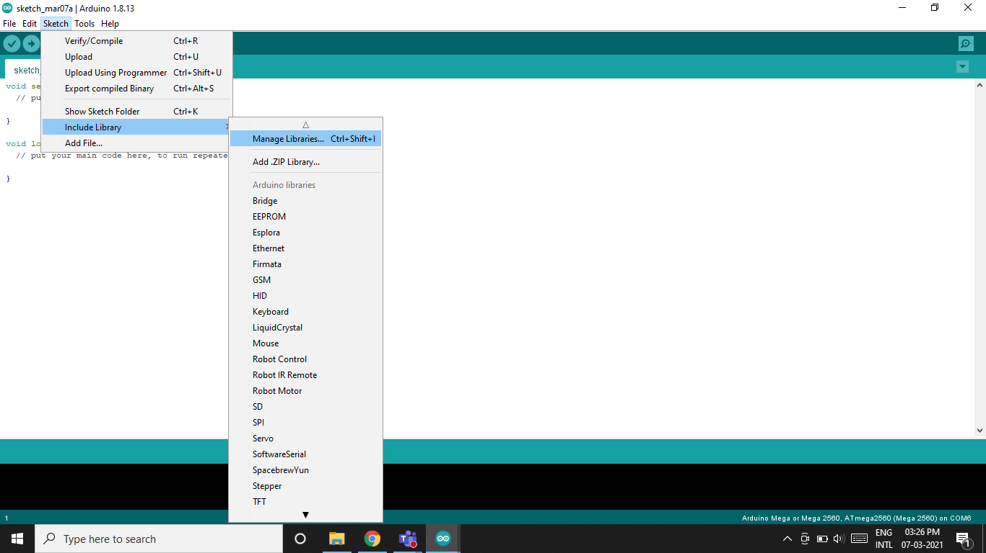
Steps to add library

Slide 30
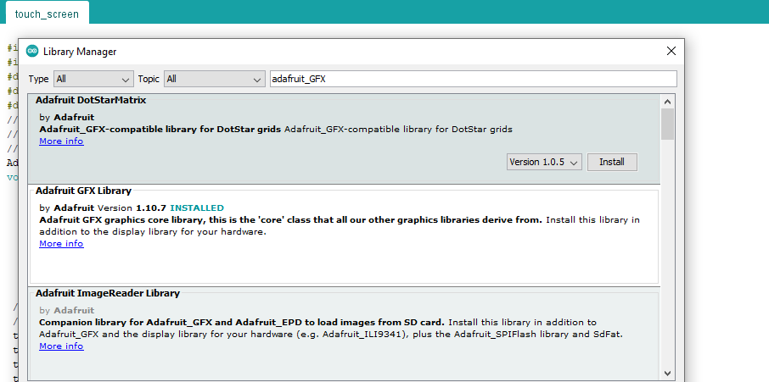
LIBRARY FOR GRAPHICS

Slide 31
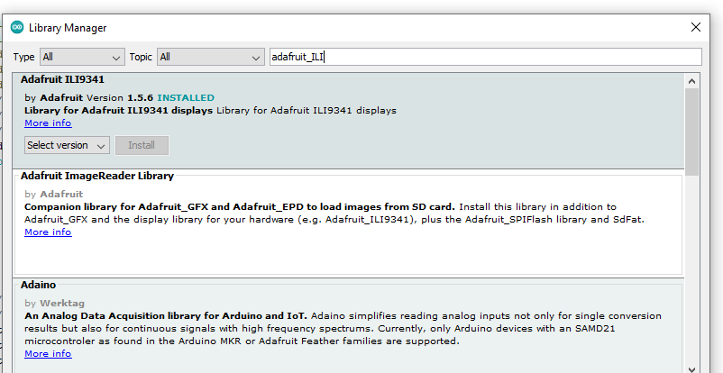
Library for the TFT

Slide 32

Coding

Slide 33
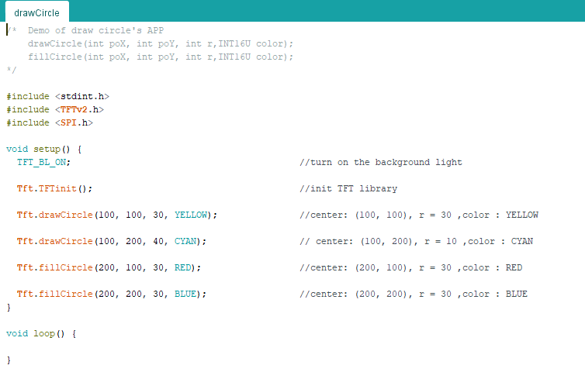
Running the example code from IDE for testing

Slide 34
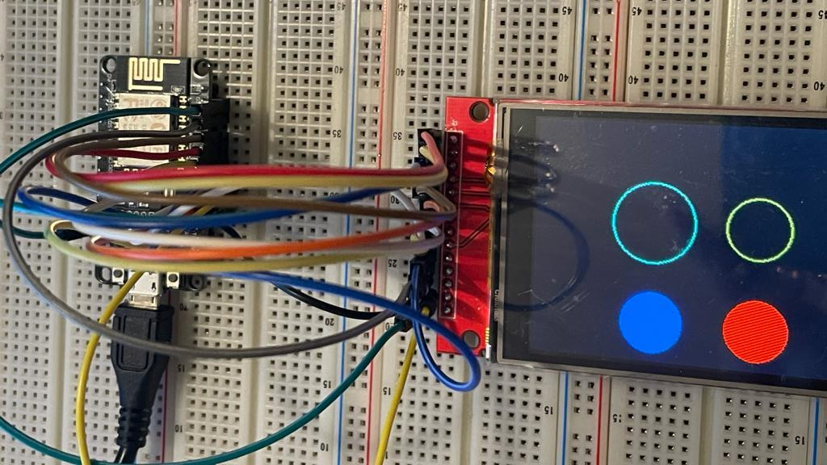
OUTPUT

Slide 35
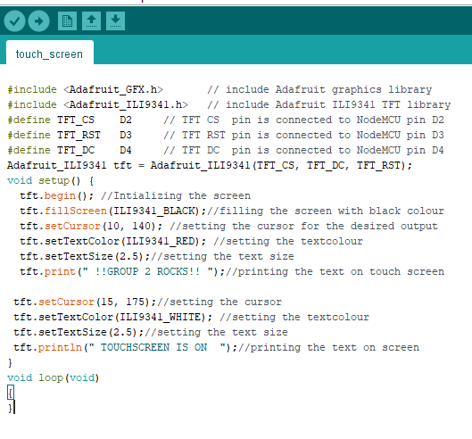
CODE FOR DISPLAYING THE TEXT ON TOUCHSCREEN

Slide 36
Describing the libraries required

Slide 37
Setting the Functions for screen

Slide 38
Why void loop is empty?
As the output will remain on the screen, till the screen is not turned OFF. Because we are not using any looping or any delay. Once, the code is flashed on the board, the output will remain on the screen till it is OFF.

Slide 39
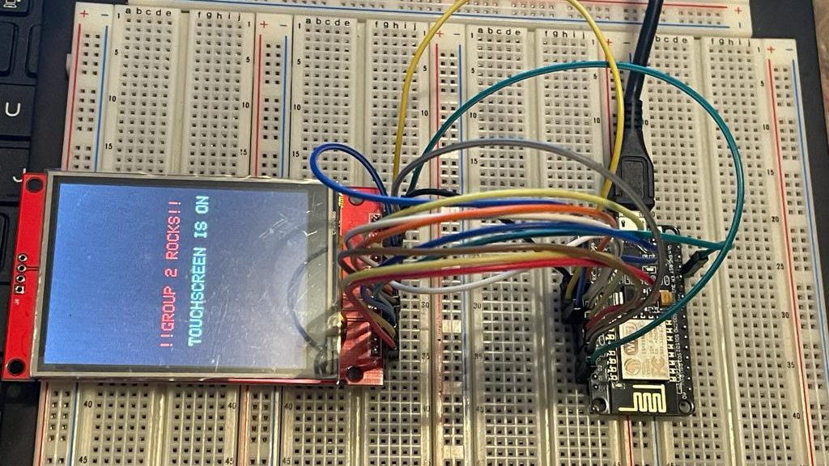
Output

Slide 40
References
For SPI: https://www.circuitbasics.com/basics-of-the-spi-communication-protocol/
For SPI: https://learn.sparkfun.com/tutorials/serial-peripheral-interface-spi/all
For libraries: https://protosupplies.com/product/tft-lcd-2-8-240x320-rgb-spi-display-with-touchscreen/
Pin Manual: http://www.lcdwiki.com/res/MSP2807/2.8inch_SPI_Module_MSP2807_User_Manual_EN.pdf
Touchscreen: https://www.amazon.ca/Display-Module-240x320-Serial-ILI9341/dp/B07BDML7LM/ref=pd_sbs_3?pd_rd_w=lNfqj&pf_rd_p=ac0ba40f-1b2a-4803-91f7-9d36ccf6dbf9&pf_rd_r=957MY4CXH80WZS18T1AS&pd_rd_r=261b631a-d12e-4b5d-973b-5b066d763a32&pd_rd_wg=e7nNi&pd_rd_i=B07BDML7LM&psc=1

Slide 41
References
Connecting touchscreen with ESP8266: https://nobrok.com/connecting-tft-lcd-touch-screen-with-nodemcu-esp8266/
Interfacing touch screen with ESP8266: https://simple-circuit.com/esp8266-nodemcu-ili9341-tft-display/
Graphics library: https://learn.adafruit.com/2-8-tft-touchscreen/graphics-library
Adafruit ILI9321: https://learn.adafruit.com/adafruit-2-8-tft-touch-shield-v2/graphics-test
Functions for TFT: https://www.arduino.cc/en/Reference/TFTSetTextSize
Restive Touchscreen: https://forum.digikey.com/t/resistive-touch-vs-capacitive-touch-whats-the-difference/1063

Slide 42
References
Difference between resistive and capacitive touch screen: https://www.makeuseof.com/tag/differences-capacitive-resistive-touchscreens-si/#:~:text=If%20you%20pay%20attention%2C%20you,the%20use%20of%20a%20stylus.
Resistive touch screen: https://store.open-electronics.org/LCD-TOUCH-2,8SPI-LCDTOUCH28SER

